Slide 1

Streamify
One Platform. All Your Streaming.
Development Cycle: 10 Days

Slide 2
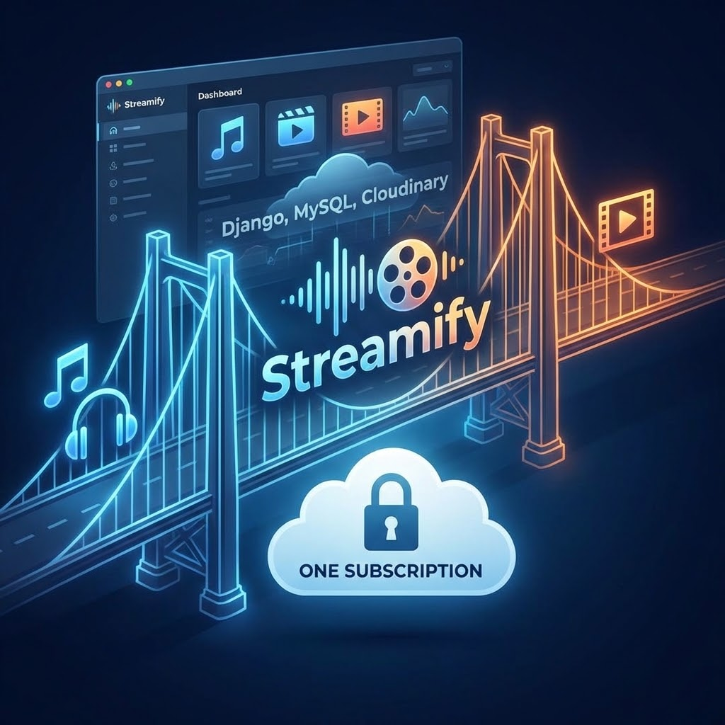

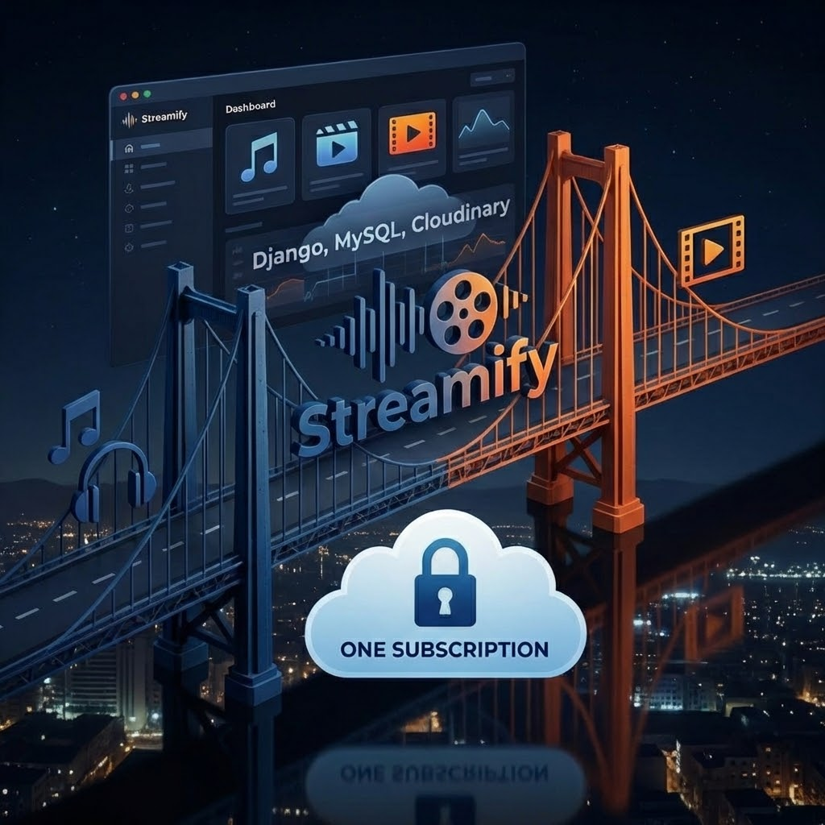
Executive Summary
Streamify is a unified web-based platform bridging the gap between music and video streaming. By consolidating services, it eliminates the need for multiple subscriptions.
The system leverages Django, MySQL, and Cloudinary to deliver a modular, production-ready SaaS prototype that solves severe media fragmentation.

Slide 3


The Problem: Media Fragmentation
Subscription Fatigue
Context Switching
Modern users are burdened by the rising costs of maintaining separate subscriptions for Spotify, Apple Music, Netflix, and Hulu. The cumulative monthly expense frequently exceeds Rs. 1000 for standard media consumption.
Constantly switching between completely different user interfaces to transition from listening to music to watching a video interrupts the user experience, causing friction and lowering overall platform retention.
The Streamify Solution: Consolidate the media experience. One login. One payment. Infinite entertainment.

Slide 4
Business Objectives
Secure Authentication: Implement robust, OTP-based login systems to guarantee data privacy and user security.
Unified Streaming: Ensure the successful, buffer-free delivery of both high-quality audio and video formats.
Subscription Validation: Deploy strict access controls, verifying active subscriptions prior to granting premium content access.
Cloud-Based Scalability: Utilize Cloudinary media storage to unburden local infrastructure and ensure rapid, scalable asset delivery.
Modular Architecture: Build a maintainable, modern SaaS framework designed for iterative expansion and future commercialization.

Slide 5
System Architecture
Streamify utilizes a robust layered architecture dividing the backend into independent modules: Users, Content, Playlists, and Subscriptions.
Media files are stored in Cloudinary, leveraging their platform for optimized delivery, global content distribution, and advanced image/video manipulation capabilities. Meanwhile, all structured metadata, including user data, content descriptions, and indexing information, resides in a highly available MySQL database cluster. This cloud-first deployment model, utilizing specialized services for content and data, ensures high availability, fault tolerance, and seamless scaling to meet enterprise-level demands for performance and reliability.

Slide 6
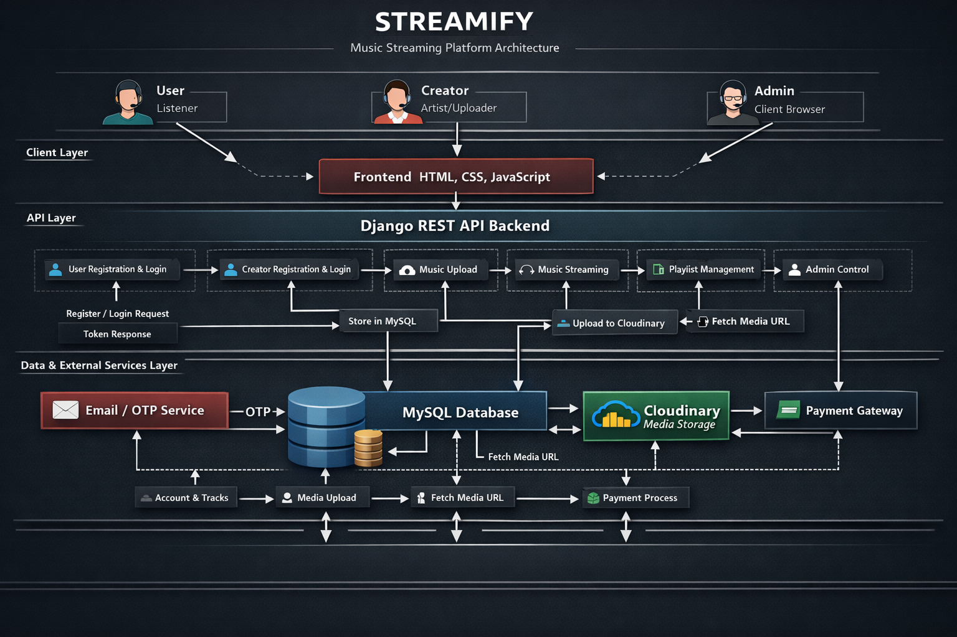

Slide 7







Technology Stack
Frontend UI
Backend Core
Database
Cloud Storage
HTML5, CSS3, & JS. Ensuring a lightweight, highly responsive, and cross-browser compatible interface.
Python with Django. Provides robust ORM, built-in security features, and rapid API capabilities.
MySQL. Enforces strict relational integrity for critical data structures like users, tiers, and playlists.
Cloudinary integration handles heavy media streaming, providing automated CDN delivery and asset optimization.

Slide 8
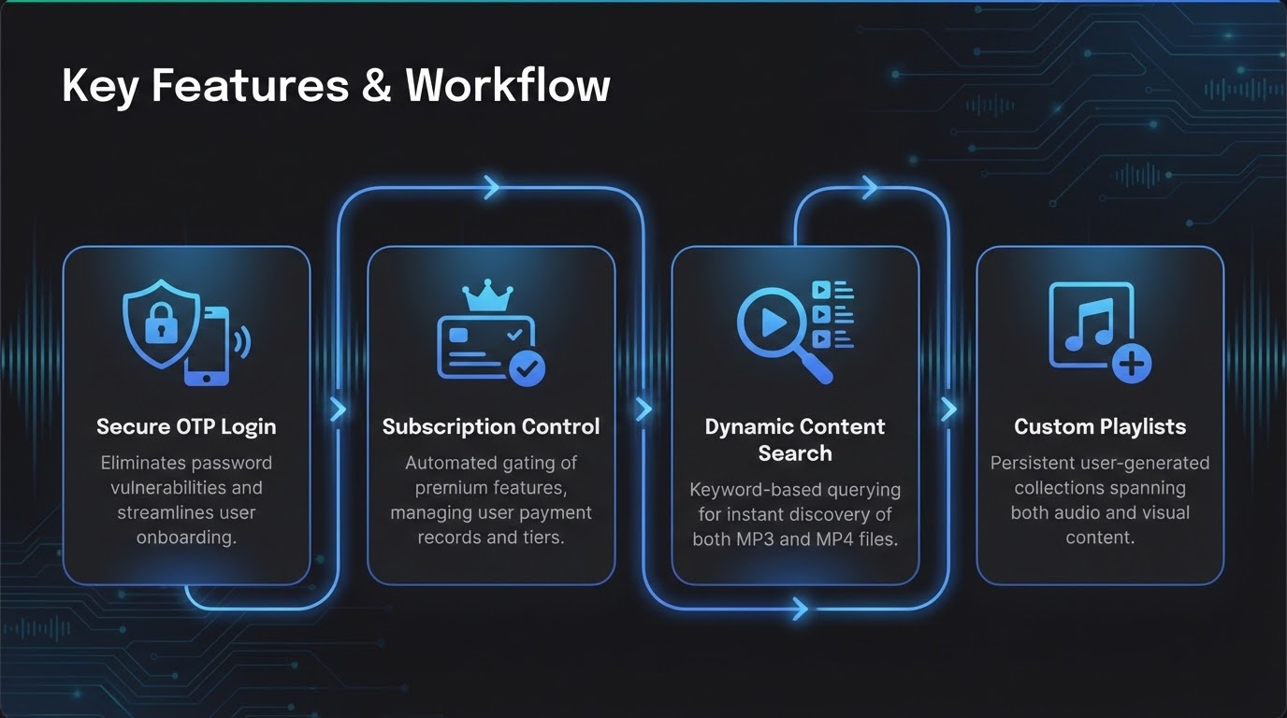

Slide 9
The Unified User Journey
Frictionless Onboarding: Users register via an encrypted OTP system. No complex passwords to remember, drastically reducing drop-off rates during account creation.
Subscription Activation: The system verifies payment records dynamically. Once approved, the unified dashboard unlocks, removing all media format restrictions instantly.
Cross-Media Discovery: Users utilize the global search bar to simultaneously query the MySQL database for both trending music artists and cinematic video releases.
Seamless Consumption: Cloudinary serves the requested MP3 or MP4 file via optimized CDN links, ensuring buffer-free playback regardless of the user's location.

Slide 10
10-Day Implementation Plan
Day 9-10
Day 4-6
FINALIZATION
BACKEND CORE
Subscription validation testing, end-to-end debugging, and documentation.
Django API development, OTP authentication flow, and database integration.
Day 1-3
Day 7-8
FOUNDATION
MEDIA & UI
Requirement analysis, initial database architecture design, and environment setup.
Frontend integration, responsive UI design, and Cloudinary API configuration.

Slide 11
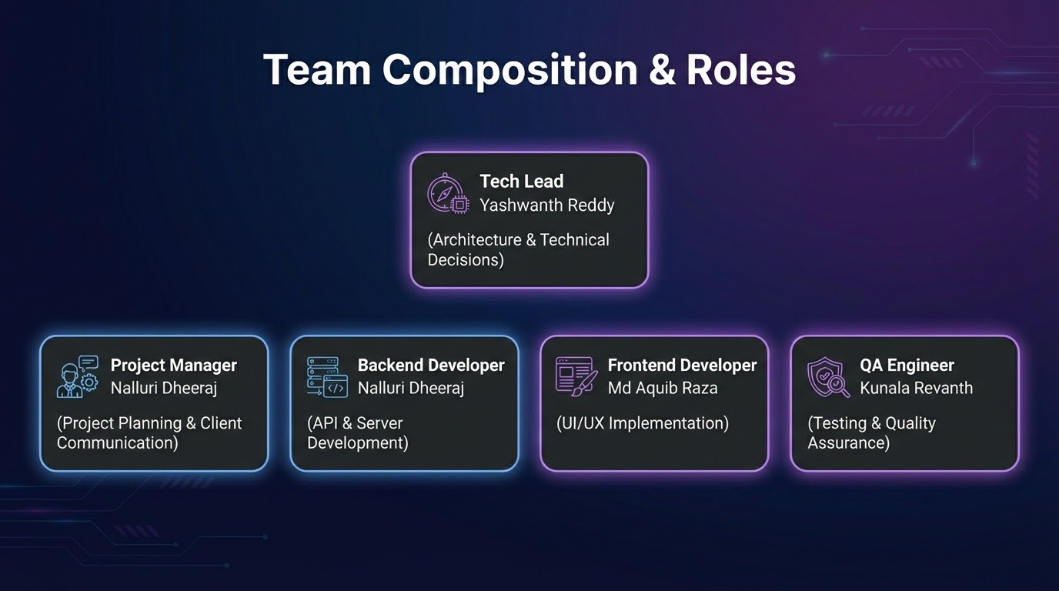


Team Composition & Roles
Architecture & Backend
Frontend & Infrastructure
Member 1 (Lead & DB): Architected the MySQL database schema, defined module boundaries, and managed overall project timeline.
Member 3 (Frontend & UX): Designed the responsive dark-theme UI, built the unified media player components, and handled API data integration.
Member 2 (Backend): Developed Django APIs, engineered the OTP authentication pipeline, and implemented rigorous subscription checks.
Member 4 (Cloud Logic): Configured Cloudinary API webhooks, managed media upload pipelines, and ensured secure asset delivery.

Slide 12


Risk Management Strategy
Storage & Scalability
Time & Dependencies
THE RISK
THE RISK
Hosting heavy MP3/MP4 files locally could crash the server and rapidly deplete resources.
Completing a unified streaming platform within a tight 10-day development sprint.
THE MITIGATION
THE MITIGATION
Completely migrated media storage to Cloudinary. This offloads bandwidth requirements and guarantees high-speed delivery regardless of traffic spikes.
Divided responsibilities strictly among 4 team members based on the modular architecture. Conducted rigorous module-level testing before final integration.

Slide 13
Security Architecture
Identity Protection: OTP-based login via email/SMS mitigates brute-force credential stuffing and eliminates weak password vulnerabilities.
Data Integrity: Django's built-in ORM actively sanitizes all database inputs, strictly preventing SQL Injection attacks.
Session Security: Protected cookie configurations and CSRF tokens secure all POST requests across the content and payment modules.
Asset Protection: Media files in Cloudinary are delivered via obfuscated, expiring URLs to prevent unauthorized hotlinking and piracy of premium content.

Slide 14
Financial Overview
1
Predictable Growth Model
If deployed commercially, operational expenses scale linearly with cloud hosting, database services, and Cloudinary storage plans.
UNIFIED SUBSCRIPTION
The revenue model centers on a single, tiered subscription plan. By offering both audio and video under one umbrella, Streamify drastically reduces customer acquisition costs and presents an irresistible value proposition to the consumer.
100%
CLOUD NATIVE

Slide 15

ROI & Business Impact
Driving User Engagement
Streamify fundamentally resolves the pain point of subscription fragmentation. Offering a unified content experience directly translates to higher user satisfaction and superior long-term retention rates.
Furthermore, our cloud-first architecture shifts the infrastructure burden, ensuring that as the user base expands, scaling remains both technically predictable and financially cost-efficient.

Slide 16
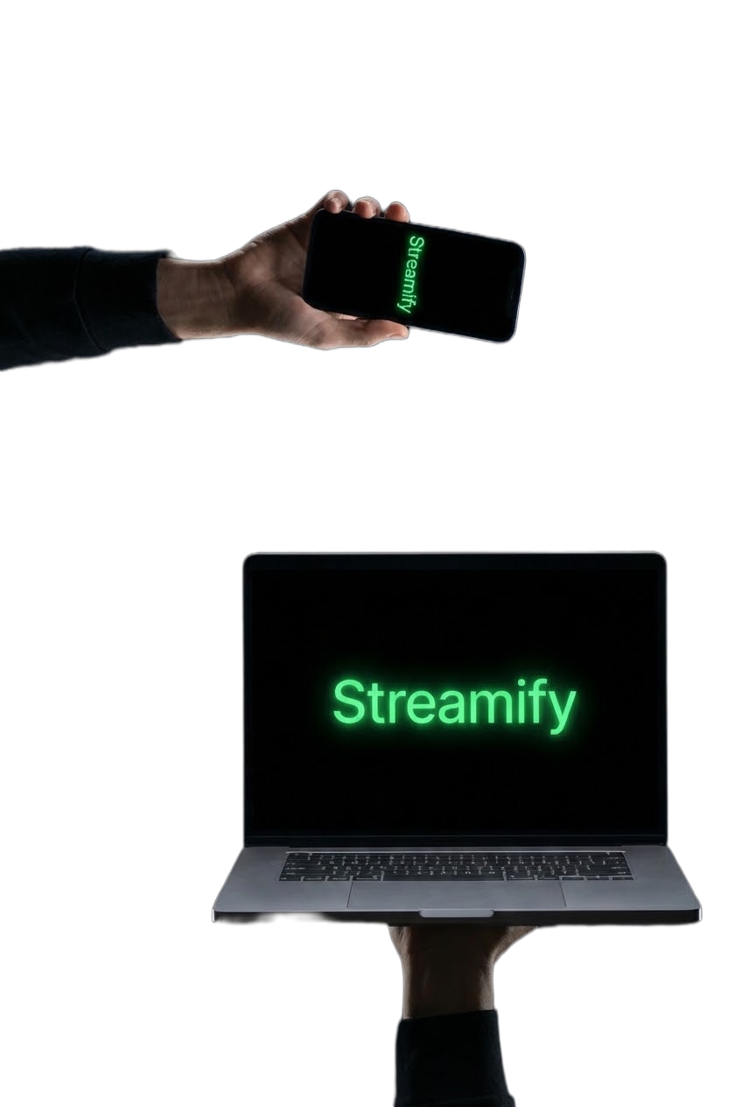
Conclusion
Streamify successfully integrates music and video streaming into a secure, modular system within just a 10-day development cycle.
It provides a highly scalable foundation equipped with cloud storage and subscription controls, perfectly positioning the platform for future AI personalization and commercial deployment.

Slide 17





Future Roadmap & Next Steps
Live Deployment
AI Enhancements
Ecosystem Expansion
Migrate the application to a dedicated cloud hosting platform and integrate a live payment gateway for real-world subscription processing.
Implement machine learning algorithms to provide personalized content recommendations based on user listening and viewing habits.
Develop dedicated iOS and Android mobile applications, integrate global CDNs, and build advanced analytics dashboards for creators.

Slide 18
Questions?
Thank you for your time and attention.

